Slide 1

Fitness Tracker
2210030039-AMBICA
2210030040-HARI PRIYA
2210030369-MEGHANA REDDY
2210030379-SAI TEJARTHA REDDY

Slide 2
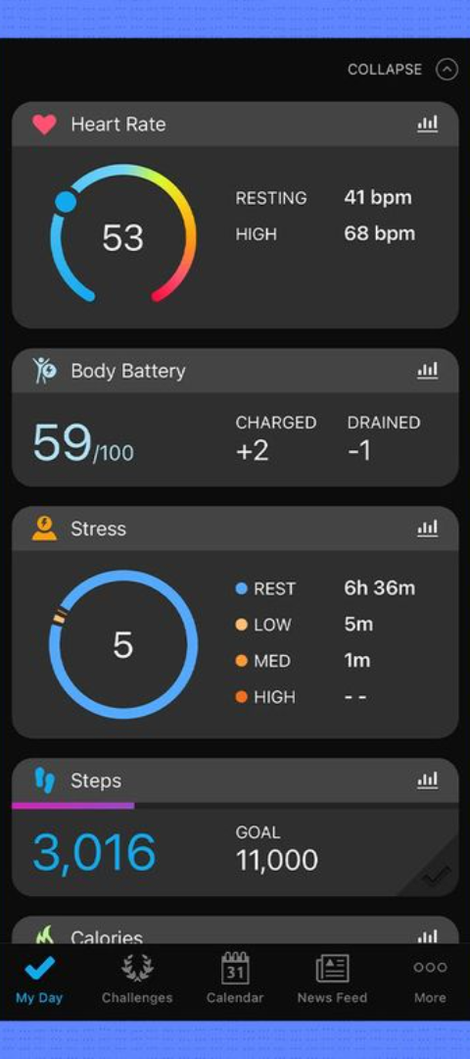
Introduction to the Fitness Tracker App
1
Motivation
The app aims to help users track and achieve their fitness goals, providing a comprehensive platform for monitoring and improving overall health.
2
Target Audience
The app caters to individuals of all fitness levels, from beginners to advanced enthusiasts, focusing on personalized fitness tracking and guidance.
3
Key Features
The app offers features like workout logging, nutrition tracking, goal setting, and progress monitoring.

Slide 3

Features of the Fitness Tracker App
Workout Tracking
Nutrition Monitoring
Goal Setting & Analysis
Users can log their workouts, record progress, and track exercise history, ensuring effective fitness regime management.
The app enables users to monitor their daily dietary intake, set nutritional goals, and access personalized diet recommendations.
Users can set fitness goals, track progress, and analyze performance metrics to refine and achieve their fitness objectives.

Slide 4




Integration of MERN Stack in the App Development
MongoDB
Express
React
Node.js
Secure and scalable NoSQL database for efficient data storage and retrieval.
Fast and minimalist web application framework for robust and rapid backend development.
Powerful JavaScript library for building UI components and creating interactive user interfaces.
Efficient and lightweight runtime environment for executing server-side JavaScript applications.

Slide 5
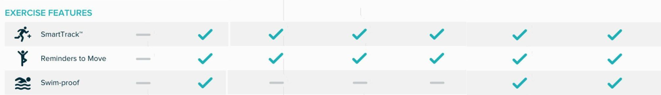
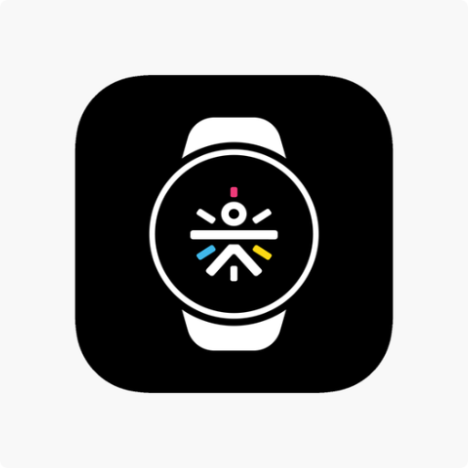
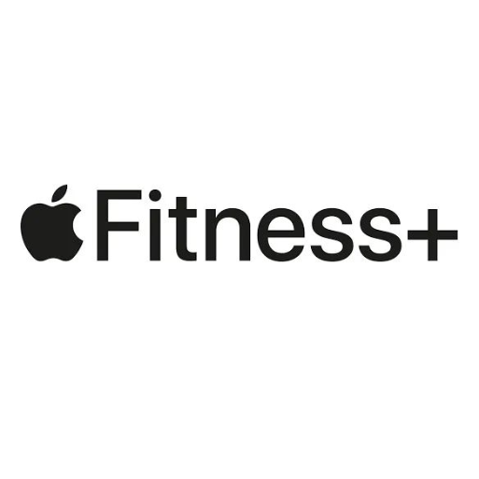
Other Apps Like This
CULT FIT
APPLE FITNESS PLUS

Slide 6

WHAT IS NEW?
1
CALORIE TRACKER-Calories and Diet Plan
2
ACTIVITY TRACKING
3
LIVE STREAMING CHALLENGES AND MOTIVATION
4
REWARDS AND LEADER BOARDS
5
VIRTUAL COACHES

Slide 7

DIET PLANS
The app offers a variety of diet plans tailored to individual needs, including options for weight loss, muscle gain, and overall healthy eating. Each diet plan includes a detailed meal plan, recipes, and nutritional information to help users make informed choices about their food intake. Additionally, the app provides support and guidance from nutrition experts to ensure users are on the right track towards achieving their dietary goals.

Slide 8

USES OF DIET PLANS
Weight Management
The personalized diet recommendations can be used to create effective diet plans for weight loss, weight gain, or weight maintenance.
Nutritional Education
Users can learn about the nutritional value of different foods and understand how to make healthier choices in their daily diet.
Health Conditions
Diet plans can be tailored to meet the specific dietary needs of individuals with health conditions such as diabetes, high blood pressure, or food allergies.

Slide 9

Benefits of Using the Fitness Tracker App
1
Personalized Guidance
2
Motivational Support
3
Health Insights
Users gain valuable insights into their health metrics, fostering a proactive and preventive approach to wellness.
Users receive customized fitness plans and recommendations tailored to their goals and preferences.
The app provides motivational tools, progress tracking, and rewards to encourage consistent engagement and positive habits.

Slide 10

Conclusion and Next Steps
User Feedback
Expansion Plans
Gathering user feedback to refine and enhance app features and functionalities based on user input and preferences.
Discussing future expansions, new features, and potential partnerships for the app's growth and development.
Maintenance and Support
Outlining ongoing maintenance and support strategies for continuous app improvement and user satisfaction.

Slide 11

Thank You
Thank you for your time and consideration. We look forward to the opportunity to discuss the fitness tracker app further and address any questions or feedback.

